Slide 1

Darwin and slavery
Cross curricular: History/ English/
Design and technology
Ages: 11-14
Key stage:3
Notes:
This presentation will introduce key moments in Darwin’s life and provide a context for the accompanying activities.

Slide 2
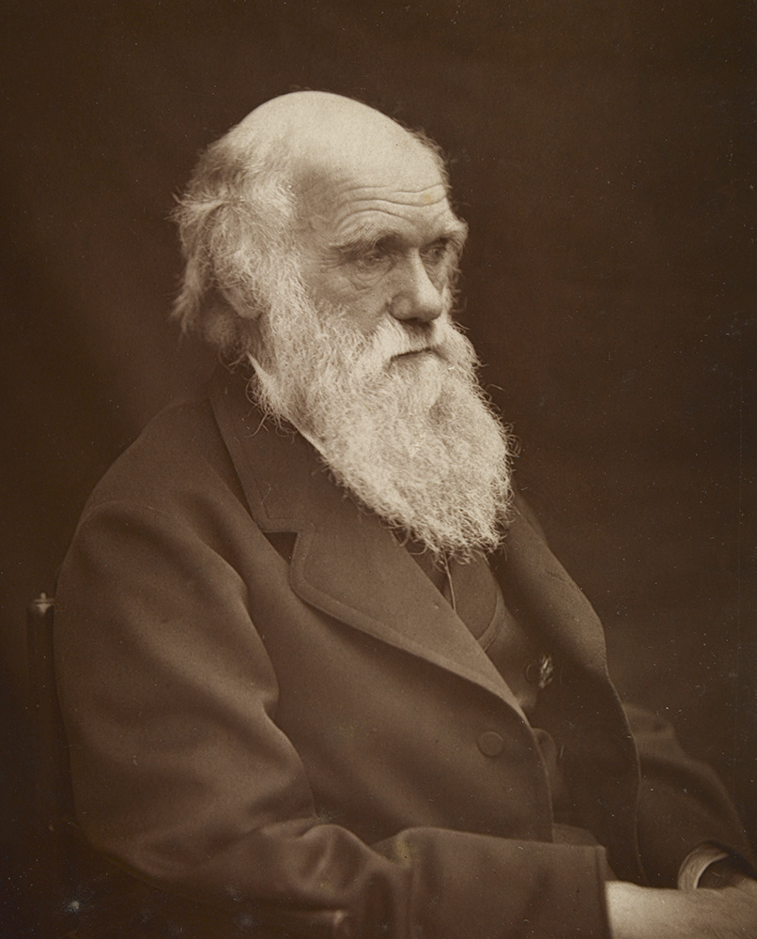
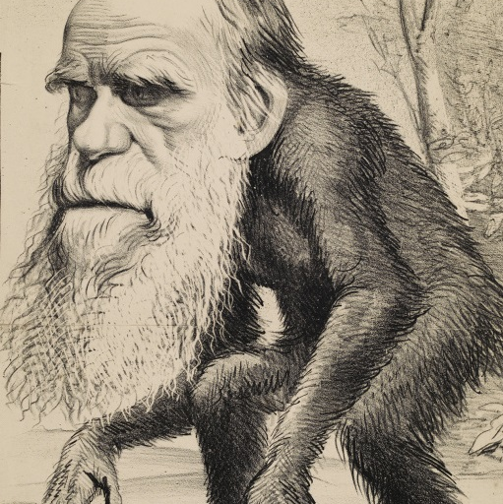
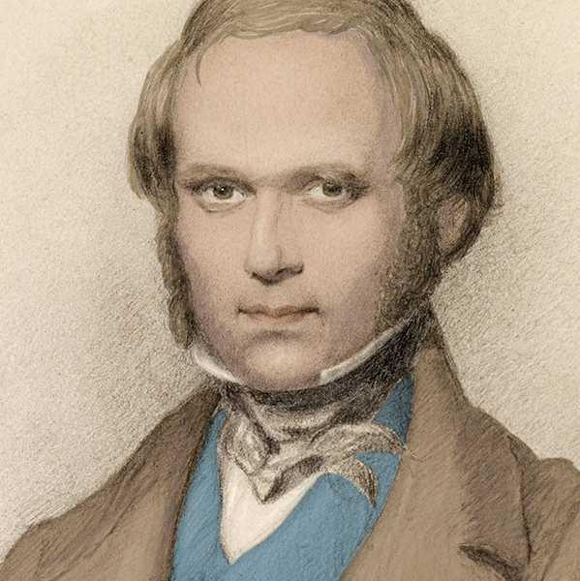
Who was Charles Darwin?
Notes:
What do we know about Darwin? What is he famous for?
Darwin was born in Shrewsbury in 1809. He had a lifelong fascination for nature, observation and
discovery. He went on to become the most influential scientist, writer and thinker on evolution.

Slide 3
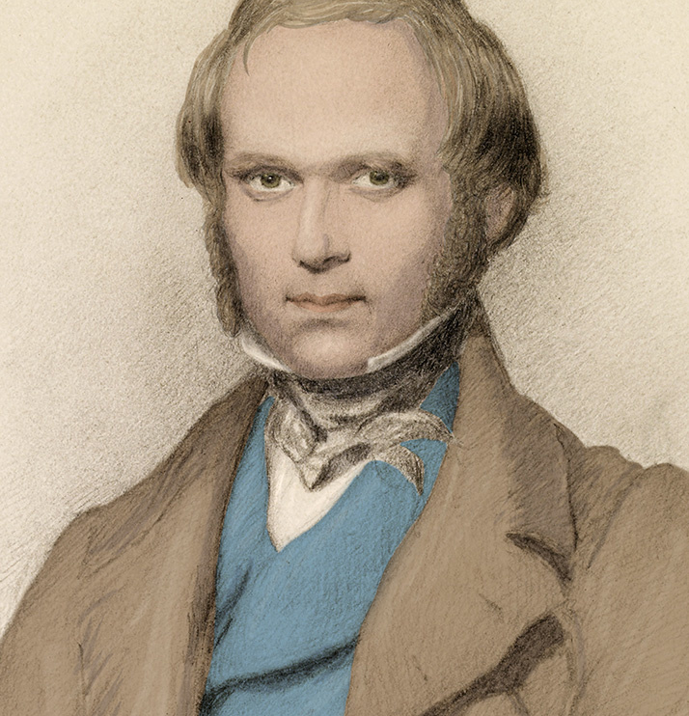
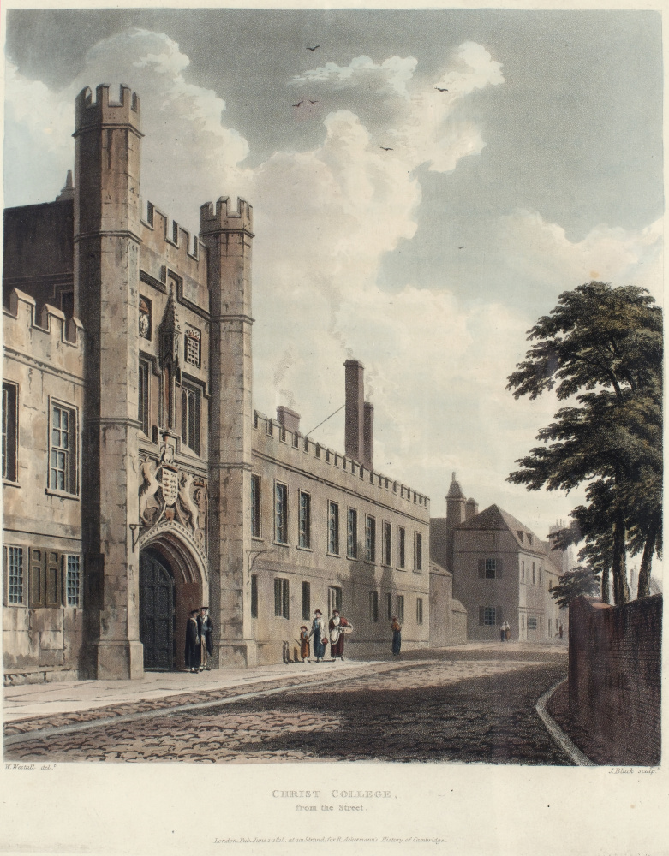
Darwin as a young man
Notes:
In 1825, when Darwin was 16, he went to Edinburgh University to study medicine but did not enjoy his studies and left after two years. He then enrolled for a classical degree at Cambridge University and was a student at Christ’s College. He had an idea to become a clergyman with a country parish. This appealed to Darwin as it would allow him to continue exploring the natural world; a common pursuit for a clergyman at that time.

Slide 4
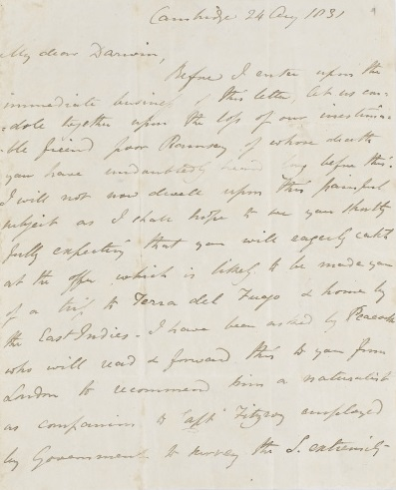
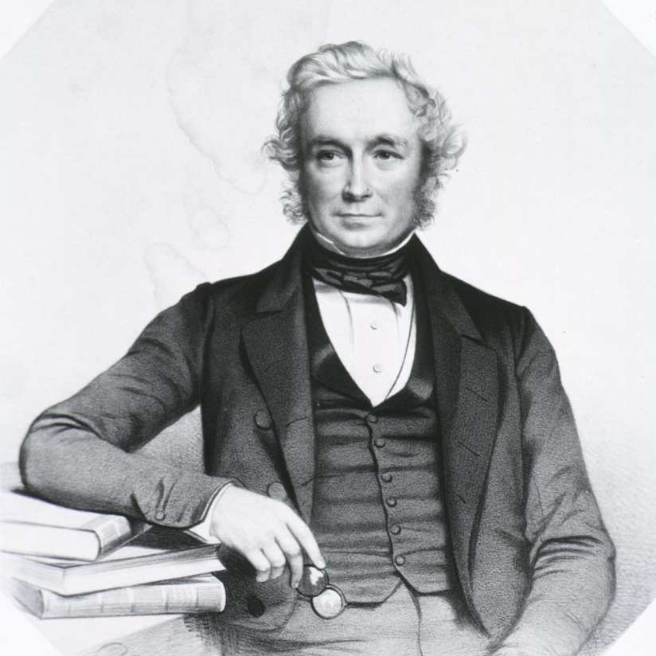
Darwin receives an offer
Notes:
In August 1831, when Darwin was 22, his botany professor, John Stevens Henslow, wrote to him unexpectedly. Henslow offered Darwin the opportunity to join the young Captain FitzRoy aboard HMS Beagle on a voyage around the world to create sea-charts. The ship was to sail round the coast of South America and home via Australia and Mauritius. The offer had been made to two others before Darwin, but they had had to turn it down for family reasons. After satisfying his father’s initial reservations, Darwin was able to accept the opportunity to join the voyage.

Slide 5
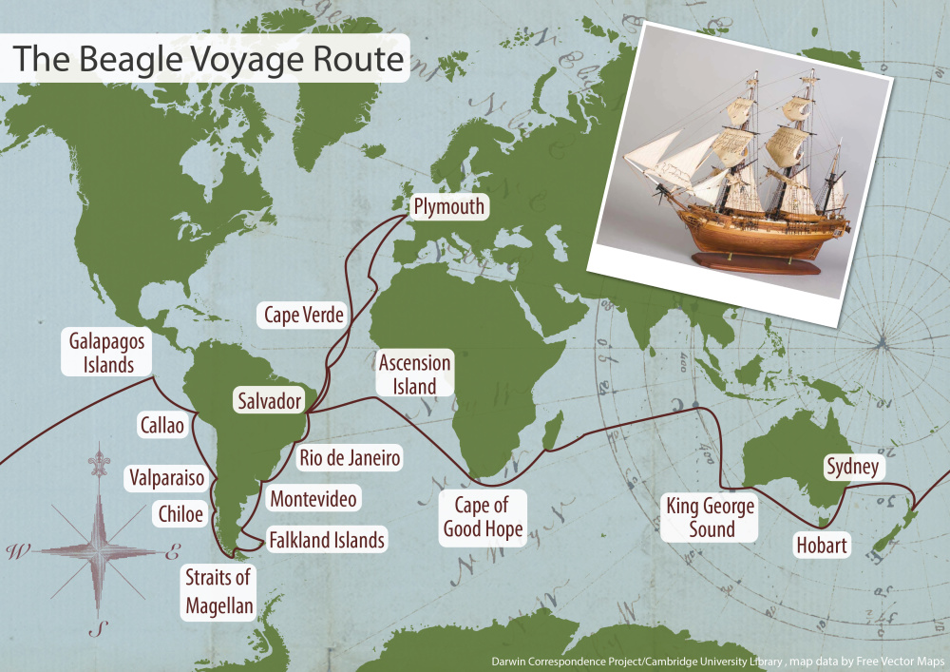
Where did the ship go?
Notes:
HMS Beagle set sail from Plymouth in December 1831. During the voyage much time was spent exploring the coastline of South America. Darwin was often free to carry out his own expeditions and spent a total of three years on land, exploring, observing and collecting. Darwin wrote regularly to his friends and family about his research, the new lands and people he encountered, and the wonder of the natural world. The ship continued to the Galápagos Islands, New Zealand, Australia and South Africa before sailing home. Darwin arrived back in Plymouth in October 1836, almost five years after setting off.

Slide 6
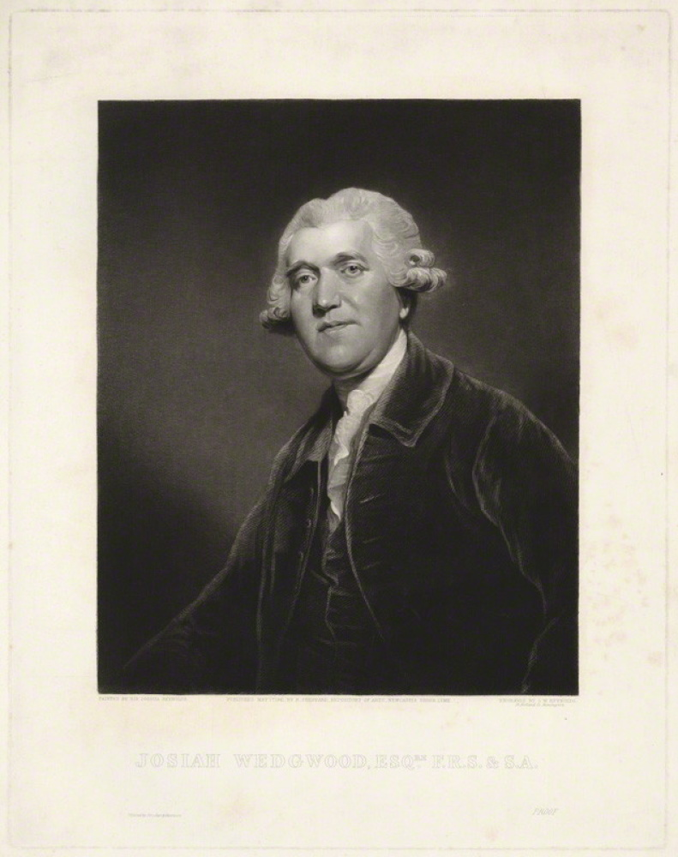
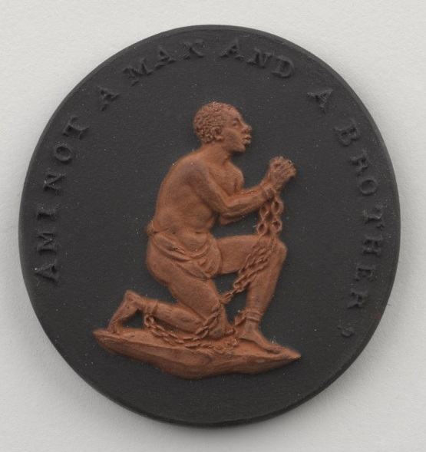
The Wedgwood medallion
Notes:
Darwin’s family was strongly against slavery and his grandfather, Josiah Wedgwood, had made a medallion based on the design for the seal for the Society for the Abolition of the Slave Trade. The cameos were mass produced and widely distributed. It was worn in bracelets, brooches, and necklaces among other fashionable items and demonstrated the wearer’s support of anti-slavery causes.
Before leaving to travel around the world Darwin was told that he would change his abolitionist views on slavery when he saw it in action. The opposite occurred; he became more convinced that slavery was a ‘monstrous stain on our boasted liberty’. He wrote to his friend John Herbert;
‘I have seen enough of Slavery & the dispositions of the negros, to be thoroughly disgusted with the lies & nonsense one hears on the subject in England.’

Slide 7
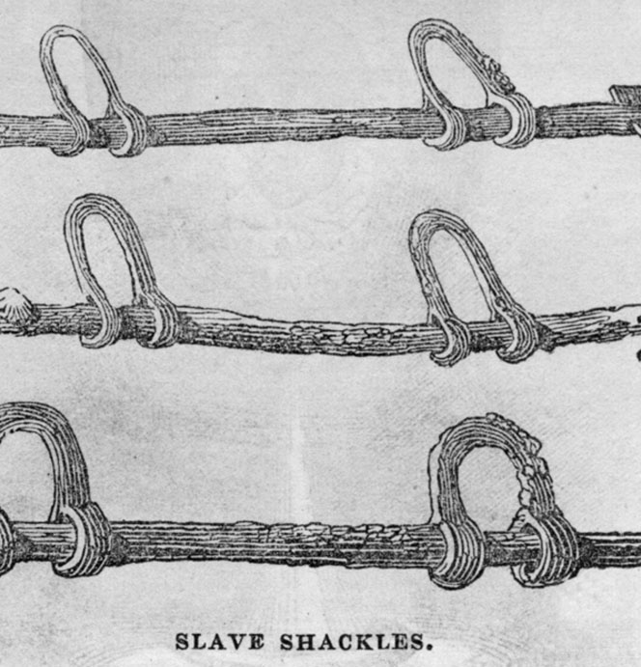
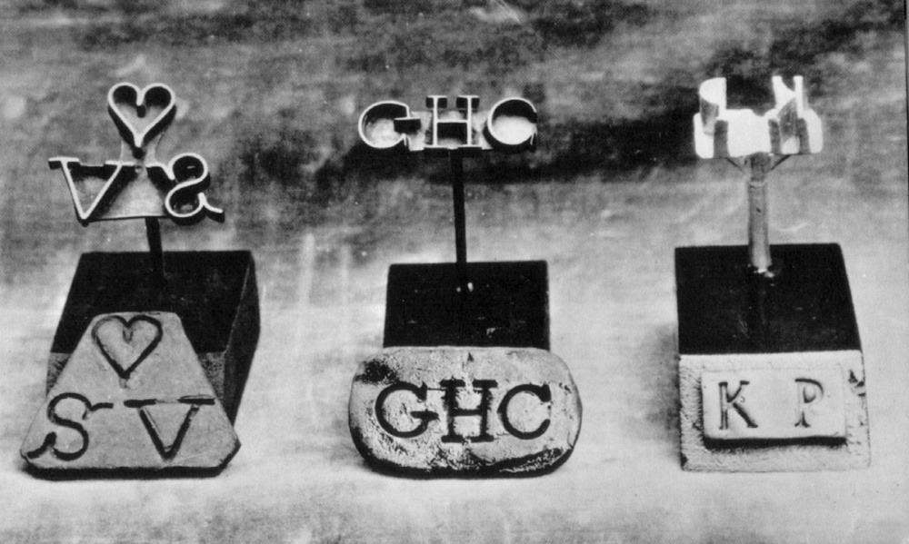
Shackles and branding irons
Notes:
These shackles were used on the long journeys of the slave ships around the time of Darwin’s voyage. The letters were the initials of slave owners that were branded on to the skin of slaves.
While travelling through South America Darwin encountered slaves working on plantations, as well as slave owners. He noted his experiences in his diary and was horrified by what he saw.
‘Near Rio de Janeiro I lived opposite to an old lady, who kept screws to crush the fingers of her female slaves. I have staid in a house where a young household mulatto, daily and hourly, was reviled, beaten, and persecuted enough to break the spirit of the lowest animal.’
He concluded:
‘On the 19th of August we finally left the shores of Brazil. I thank God, I shall never again visit a slave-country.’

Slide 8
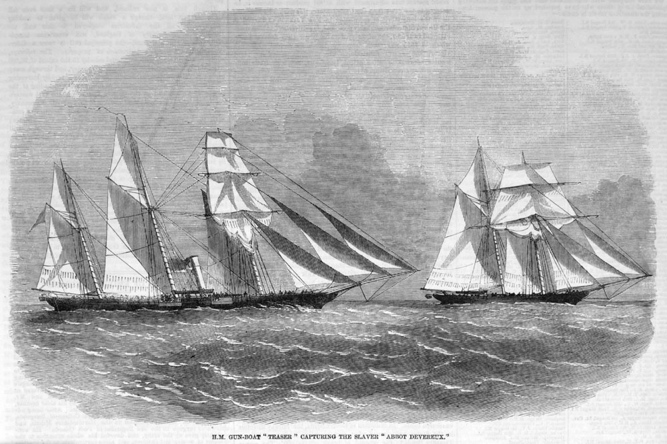
1833 Slavery Abolition Act
Notes:
In August 1833, whilst Darwin was travelling through Argentina, the Slavery Abolition Act was passed in Britain which abolished slavery throughout the British Empire (with some initial exceptions). The large sum of £20 million was paid in compensation to the slave owners for their loss of business.
Darwin’s sister Susan wrote to her brother;
‘You will rejoice as much as we do over Slavery being abolished, but it is a pity the Apprenticeship does not commence till next August as that is a great while for the poor Slaves to be at the mercy of the Planters who I shd. think wd. treat them worse than ever.— I grudge too very much the 20 million compensation money: but perhaps it would never have been settled without this sum.’

Slide 9
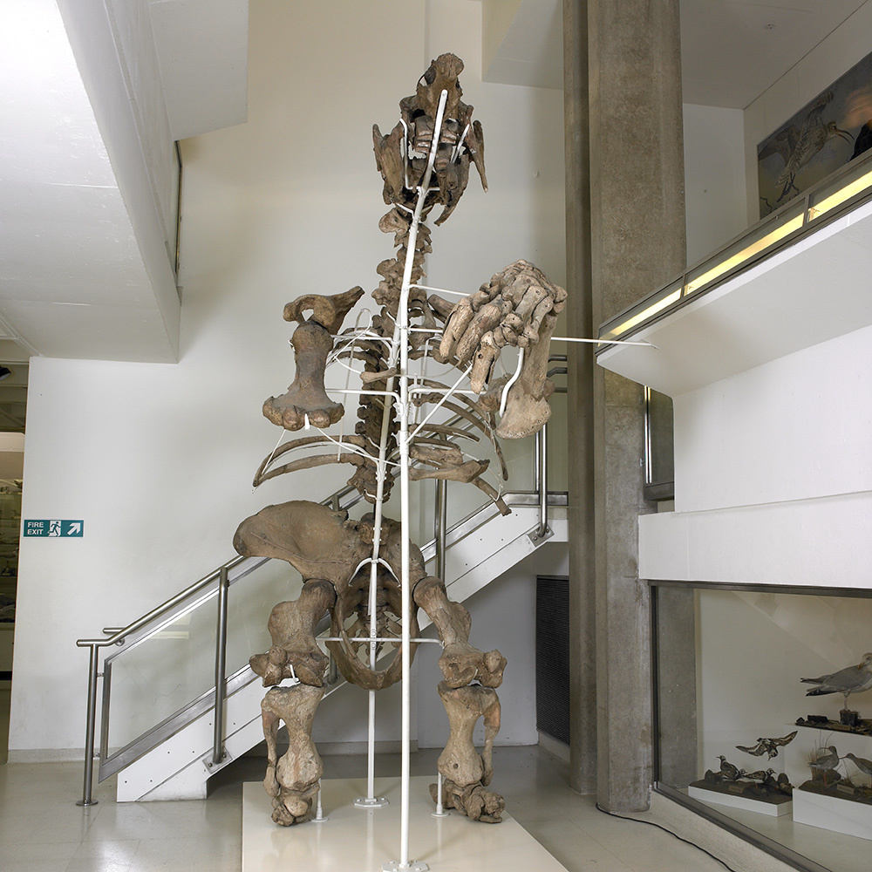
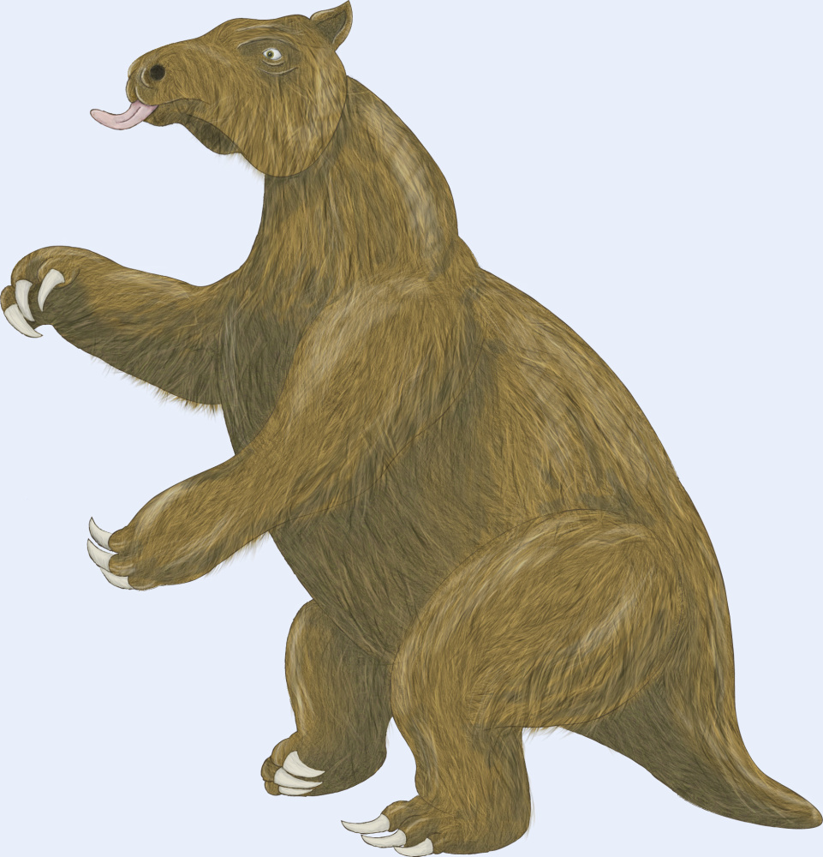
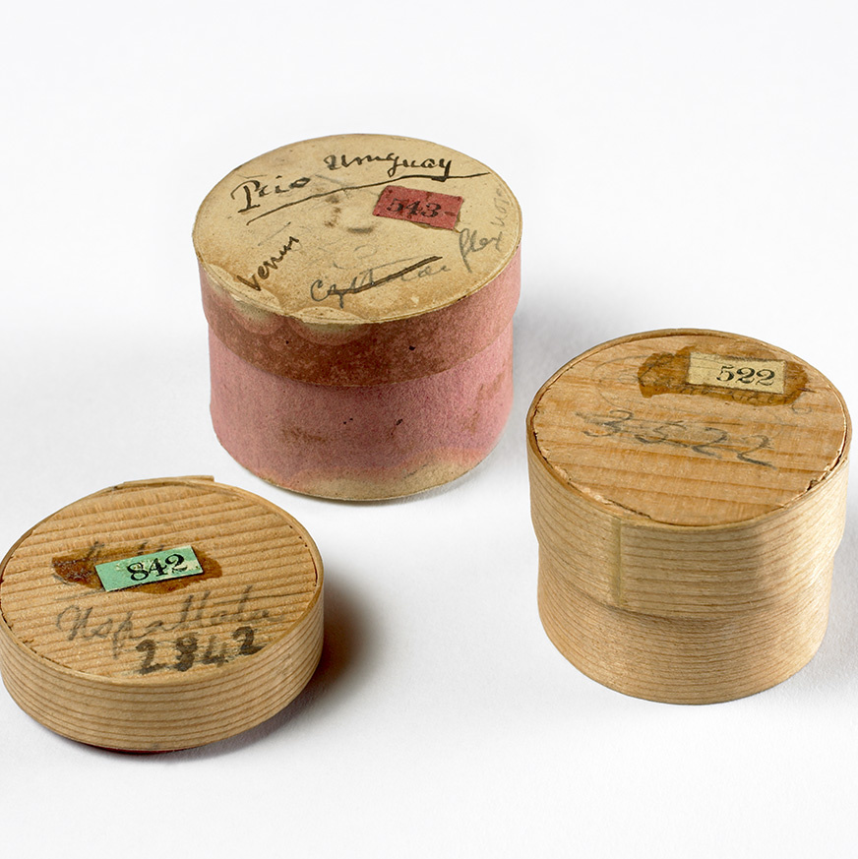
Specimens big and small
Notes:
During the five year voyage Darwin spent around three years on land. He collected and sent back many thousands of samples and specimens including rocks, fossils, insects, animals, and plants. The bones belong to a Megatherium (giant ground sloth) that lived in South America around 5.3 million years ago.
Darwin’s collections were sometimes packaged in whatever containers he had to hand, including these pill boxes which contained some of his small geology samples. The trunks full of specimens were sent home regularly via ships that were returning to England.

Slide 10
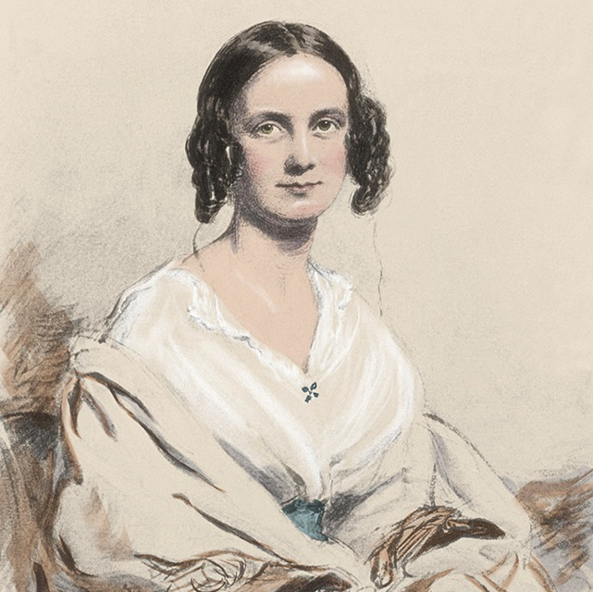
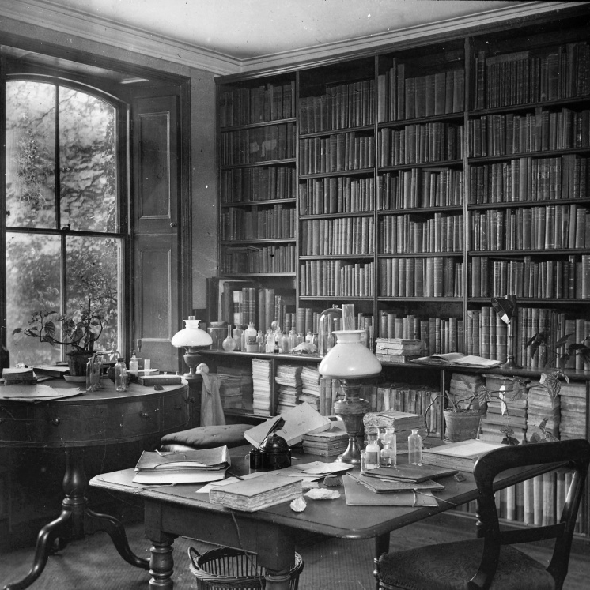
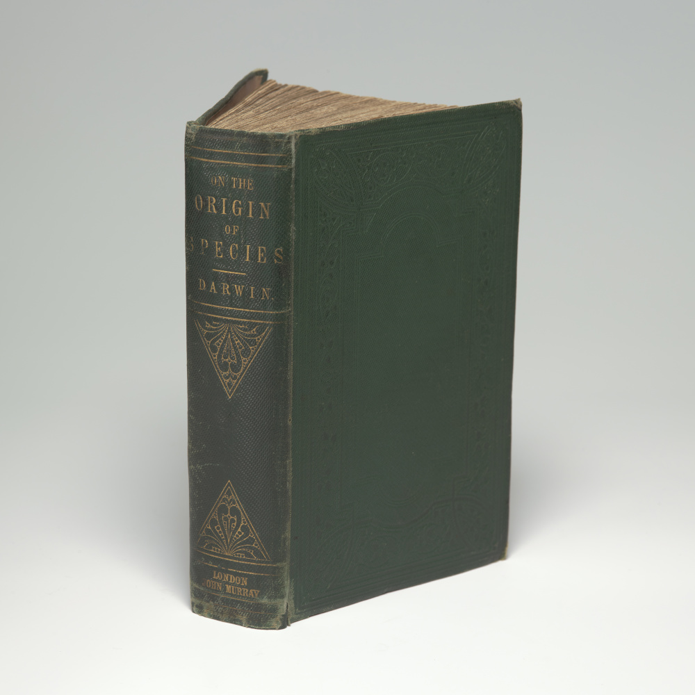
Life after the voyage
Notes:
In 1836, Darwin returned to England with a career’s worth of scientific observations. With his vast collection of new specimens and
observations, Darwin became an important member of the British scientific community. Darwin wrote four books based on the voyage,
including his popular Journal of researches. He spent twenty further years developing and testing his ideas before publishing on evolution
and natural selection.
In 1839, he married Emma Wedgwood, his first cousin. They moved to Down House in Kent in 1842, where they raised a family (ten
children, seven of whom seven survived to adulthood). His home became his workplace and he often enlisted the help of his family.
He published his most famous book, On the Origin of Species, in 1859.

Slide 11
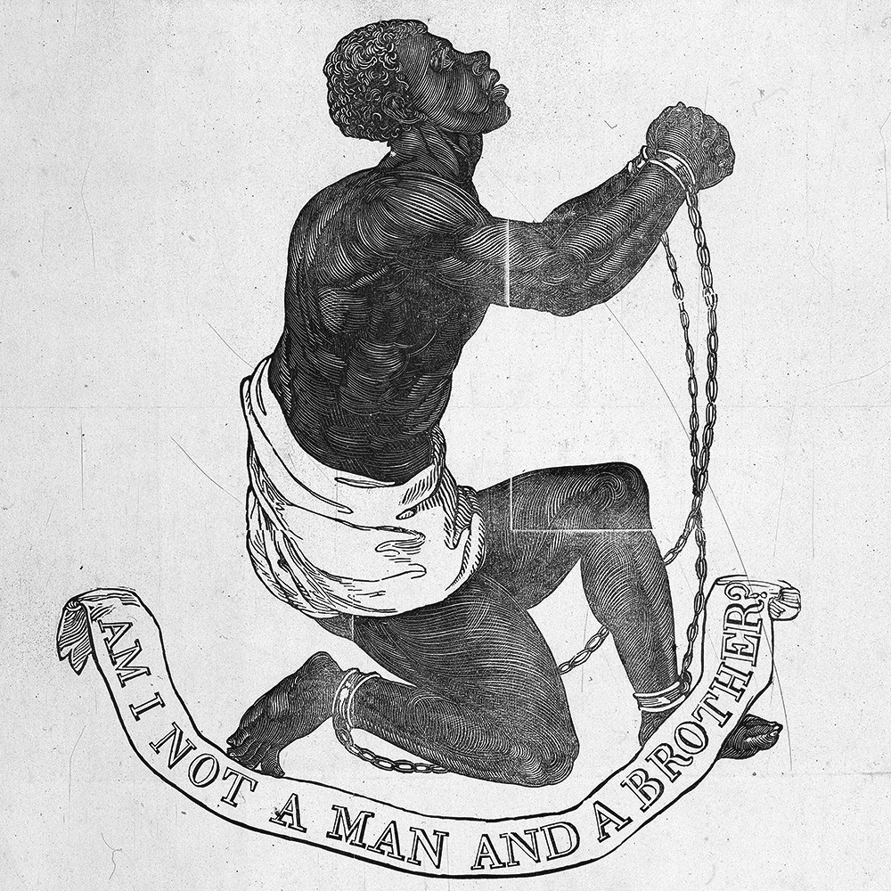
Darwin’s findings
Notes:
Although On the Origin of Species did not explicitly deal with human evolution, his following book, The Descent of Man and Selection in Relation to Sex, clearly outlines where he believed all human life to originate from. In stating that all human races and apes shared a common ancestor, Darwin challenged and provoked religious and racial views of the day. Having grown up in an abolitionist family and seen the horrors of slavery first hand, Darwin's research supported his own lived experience and personal values.

Slide 12
Acknowledgements
Images
Slide 2: Artwork based on sketch of Darwin by George Richmond held at Cambridge University Library, DAR 225:119, DAR 14.6
Slide 3: Cambridge University Library
Slide 4: US National Library of Medicine IMH (B014334), CUL (DAR 97: B4)
Slide 5: CUL, map data by Free Vector Maps
Slide 6: Brooklyn Museum, gift of Emily Winthrop Miles (CC by 3.0), Josiah Wedgwood NPG (D376630) © National Portrait Gallery , London (CC by-NC-ND 3.0)
Slide7: www.slaveryimages.org, compiled: Jerome Handler/ Michael Tuite, sponsored by Virginia Foundation for the Humanities and the University of Virginia Library
Slide 8: www.slaveryimages.org, compiled: Jerome Handler/ Michael Tuite, sponsored by Virginia Foundation for the Humanities and the University of Virginia Library
Slide 9: Images from collections at Cambridge University Museum of Zoology/ Sedgwick Museum, artist impression of Megatherium, CUL
Slide 10: CUL, artwork based on DAR 233.1:17, Keynes.M.2.27, DAR 233.2.18
Slide 11: Cambridge University Library (DAR225:119), Library of Congress, Broadside collection, (portfolio 118, no32a)

